Slide 1

Project Presentation
on
“PRAYOGAM 2025 –University Tech Fest Website”
Presented By:
AYUSH AGRAWAL (Reg. No. 2024PUFCEBCEX17514)
DISHIKA AGARWAL (Reg. No. 2024PUFCEBCEX17389)
AVANI MITTAL (Reg. No. 2024PUFCEBCEX17080)
GAURAV PRAJAPATI(Reg. No. 2024PUFCEBCEX17315)
Department of First Year
Poornima University, Jaipur
Under the Supervision of
Abhishek Kumar Singh
Megha nain
Assistant Professor,
Faculty of Computer Science and Engineering,
Poornima University, Jaipur
Submitted To:
Department of First Year
Poornima University, Jaipur

Slide 2
Contents
Introduction
What’s our Project about?
Aim of Project
Technical Details
Working of Project
Images and Videos of Project
Conclusion and Future work
References

Slide 3
PRAYOGAM – TECNOVATION
Technovation, a fest for technical and innovative ideas, is organized by the college every year for the advancement of technical knowledge in the students. The prime purpose of Technovation is to improve the technical acumen of the young and creative minds.
The Prayogam Tech Fest is organise to provide a platform for students, professionals, and industry experts to come together and showcase their innovative projects, ideas, and technologies. The festival aims to promote innovation, entrepreneurship, and collaboration among participants.

Slide 4
Objective of the fest
To encourage students to think creatively and develop innovative solutions to real-world problems.
To foster collaboration and teamwork among students from different disciplines.
To provide a platform for students to showcase their technical skills and projects

Slide 5
Aim of the website
To preserve the history and legacy of the tech fest, making it easier for future organizers and participants to learn from past experiences.
To promote the tech fest brand and establish it as a reputable and influential event in the tech community
To provide a platform for users to access and explore data related to the previous year's tech fest, such as:
Event schedules
Participant and team information
Number of participants ,projects etc.
Winning projects and descriptions.
Photos and videos from the event

Slide 6
Technology used
HTML-Provides the structure of the websites , organizing content like text, images, and videos.
CSS3-Styles the website , making it look modern and responsive , adjusting to different screen sizes.
JAVASCRIPT-Adds interactivity ,such as buttons ,form validation and dynamic content loading, improving user experience.
FRONTEND FRAMEWORKS

Slide 7
Working of the project
1.Ayush Agrawal - Developer, designing
2.Dishika Agarwal - Developer, content writer
3.Avani Mittal - Developer, tester
4.Gaurav Prajapati - Developer , documentation

Slide 8
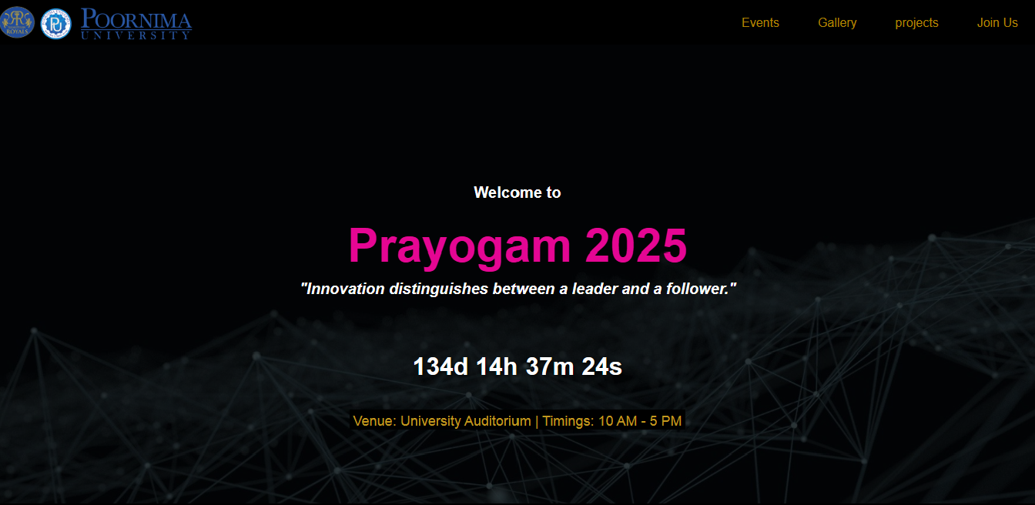

Slide 9
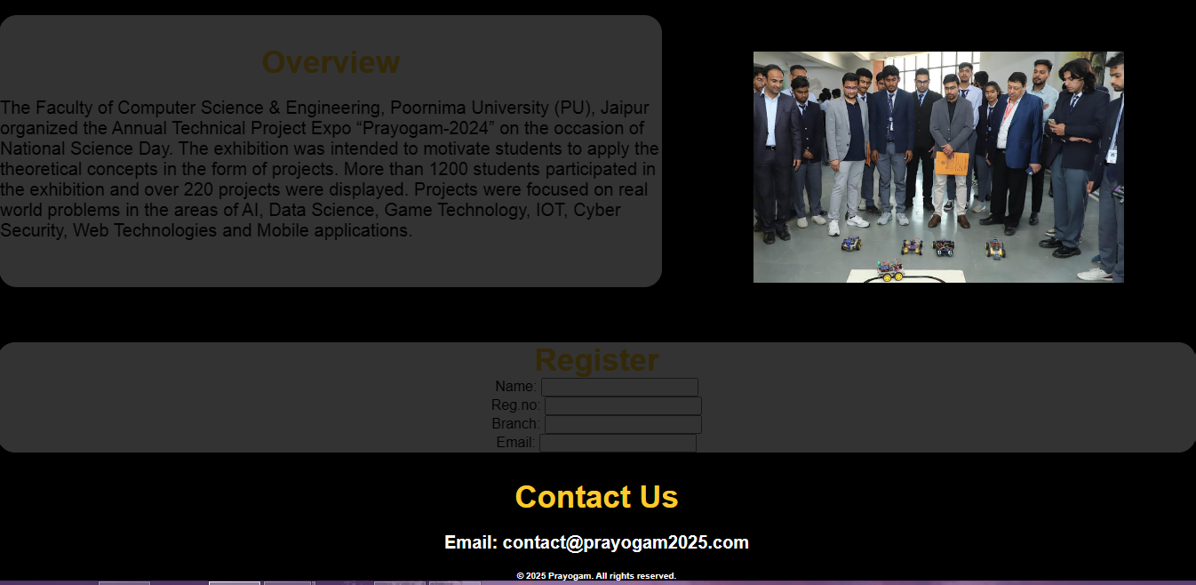

Slide 10


